Slide 1

WAY TO ENTERPRISE
Spring Framework

Slide 2
Agenda
Create/Update Form
Transaction
Validate
Assignments
Copyright © VTI Academy All Rights Reserved

Slide 3
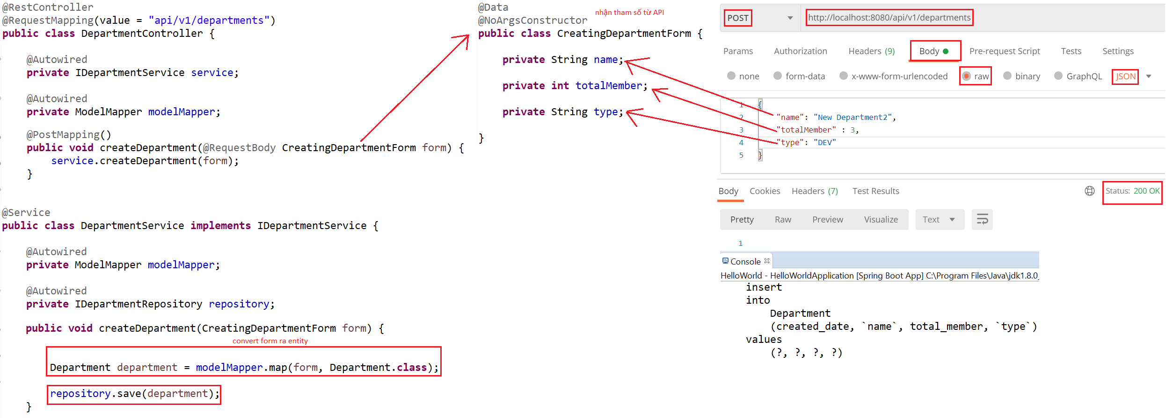
Create/Update Form
Example 1: Create & Update Form
Create

Slide 4
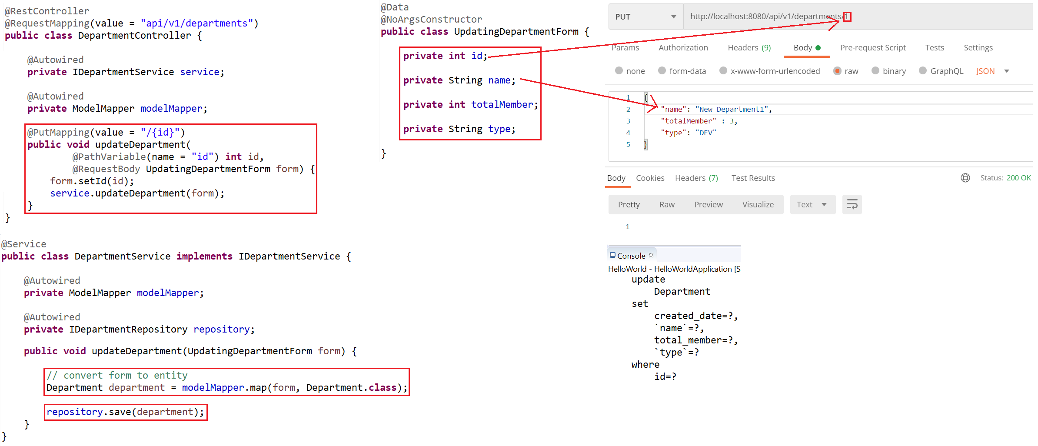
Create/Update Form
Update

Slide 5
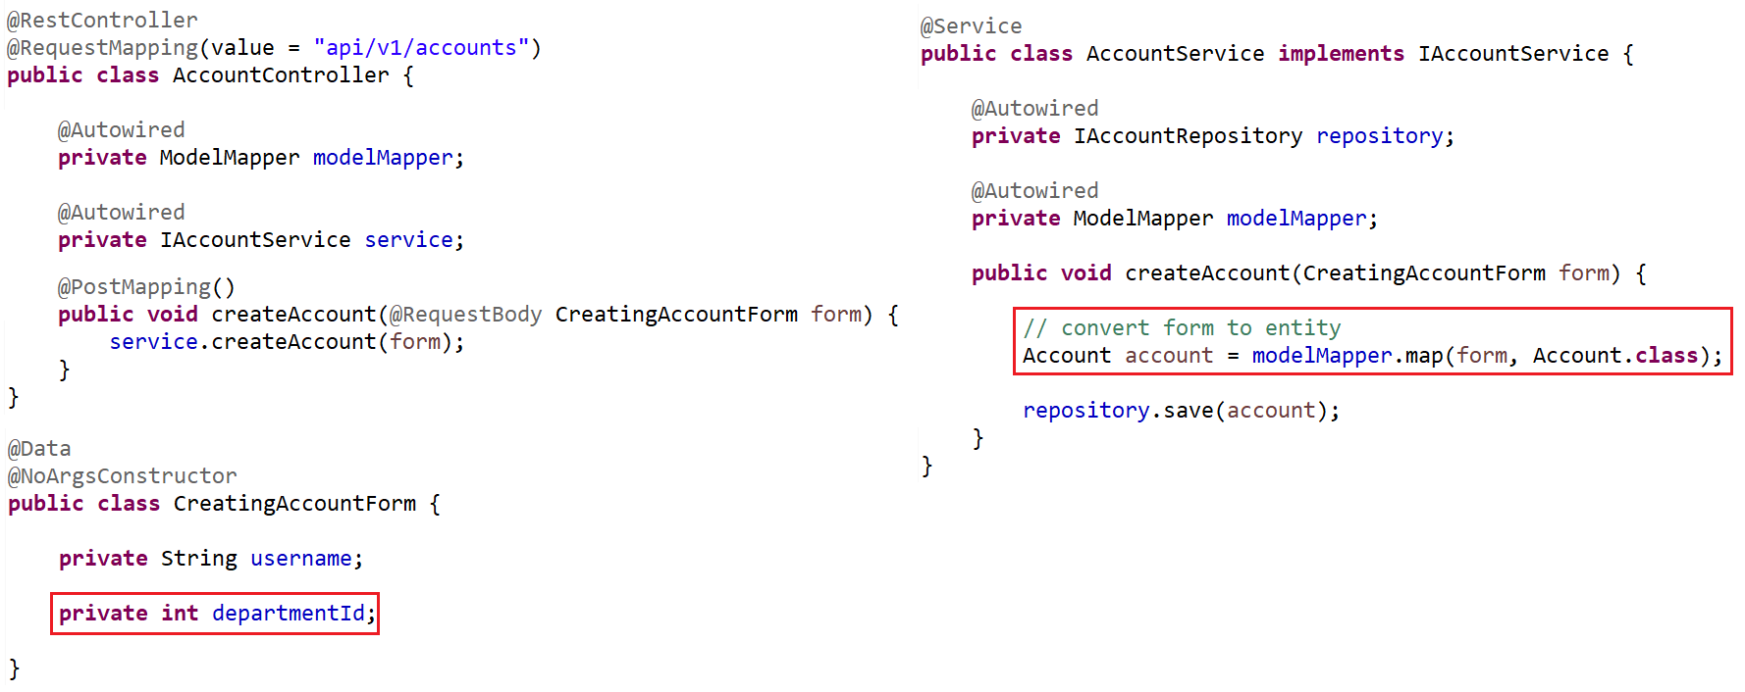
Create/Update Form
Example 2: Create Account & assign department
  ModelMapper Error

Slide 6
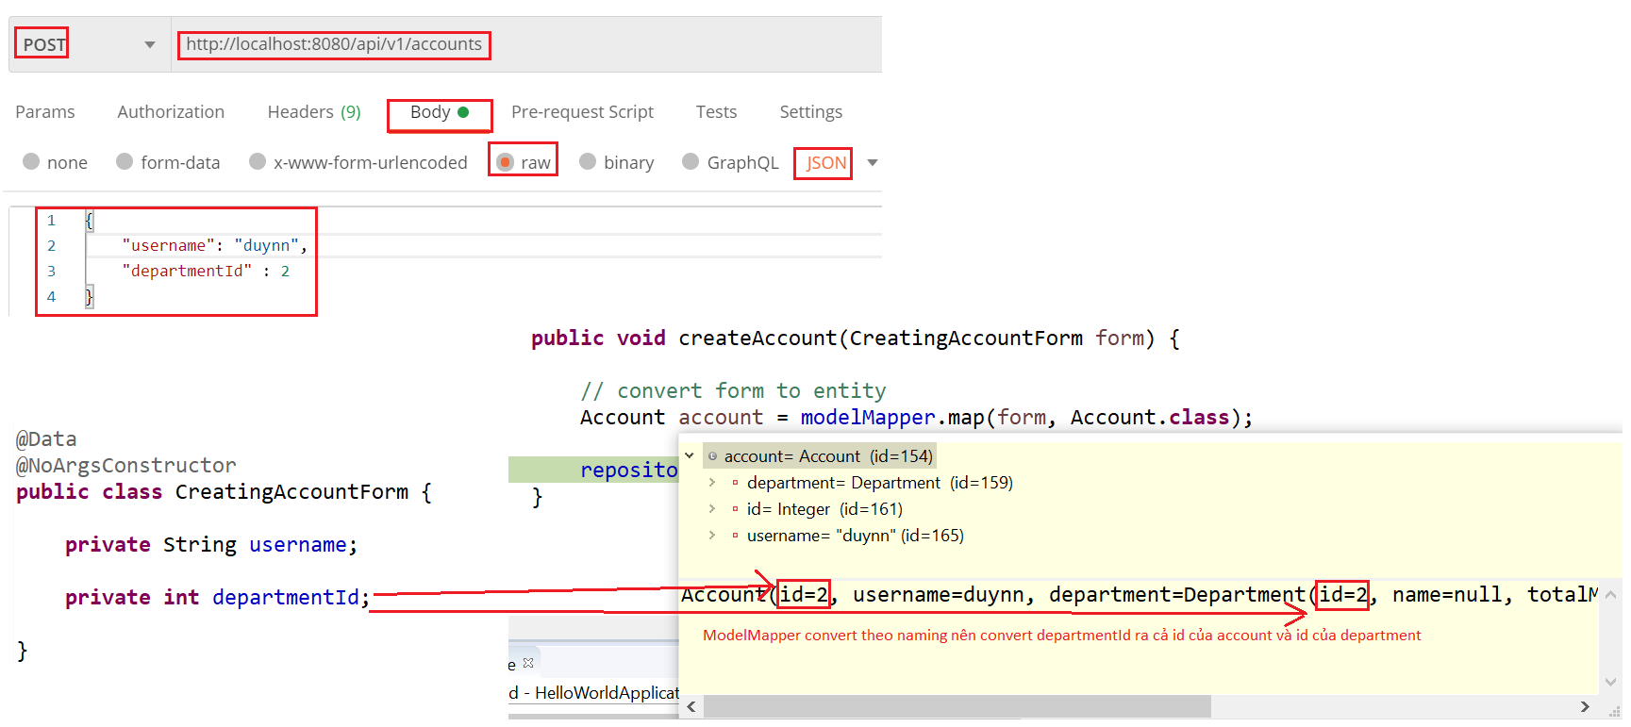
Create/Update Form
Error

Slide 7
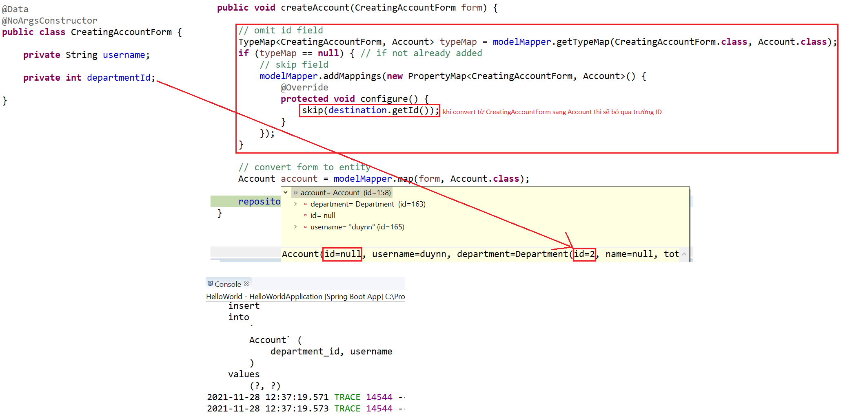
Create/Update Form
  Fix

Slide 8
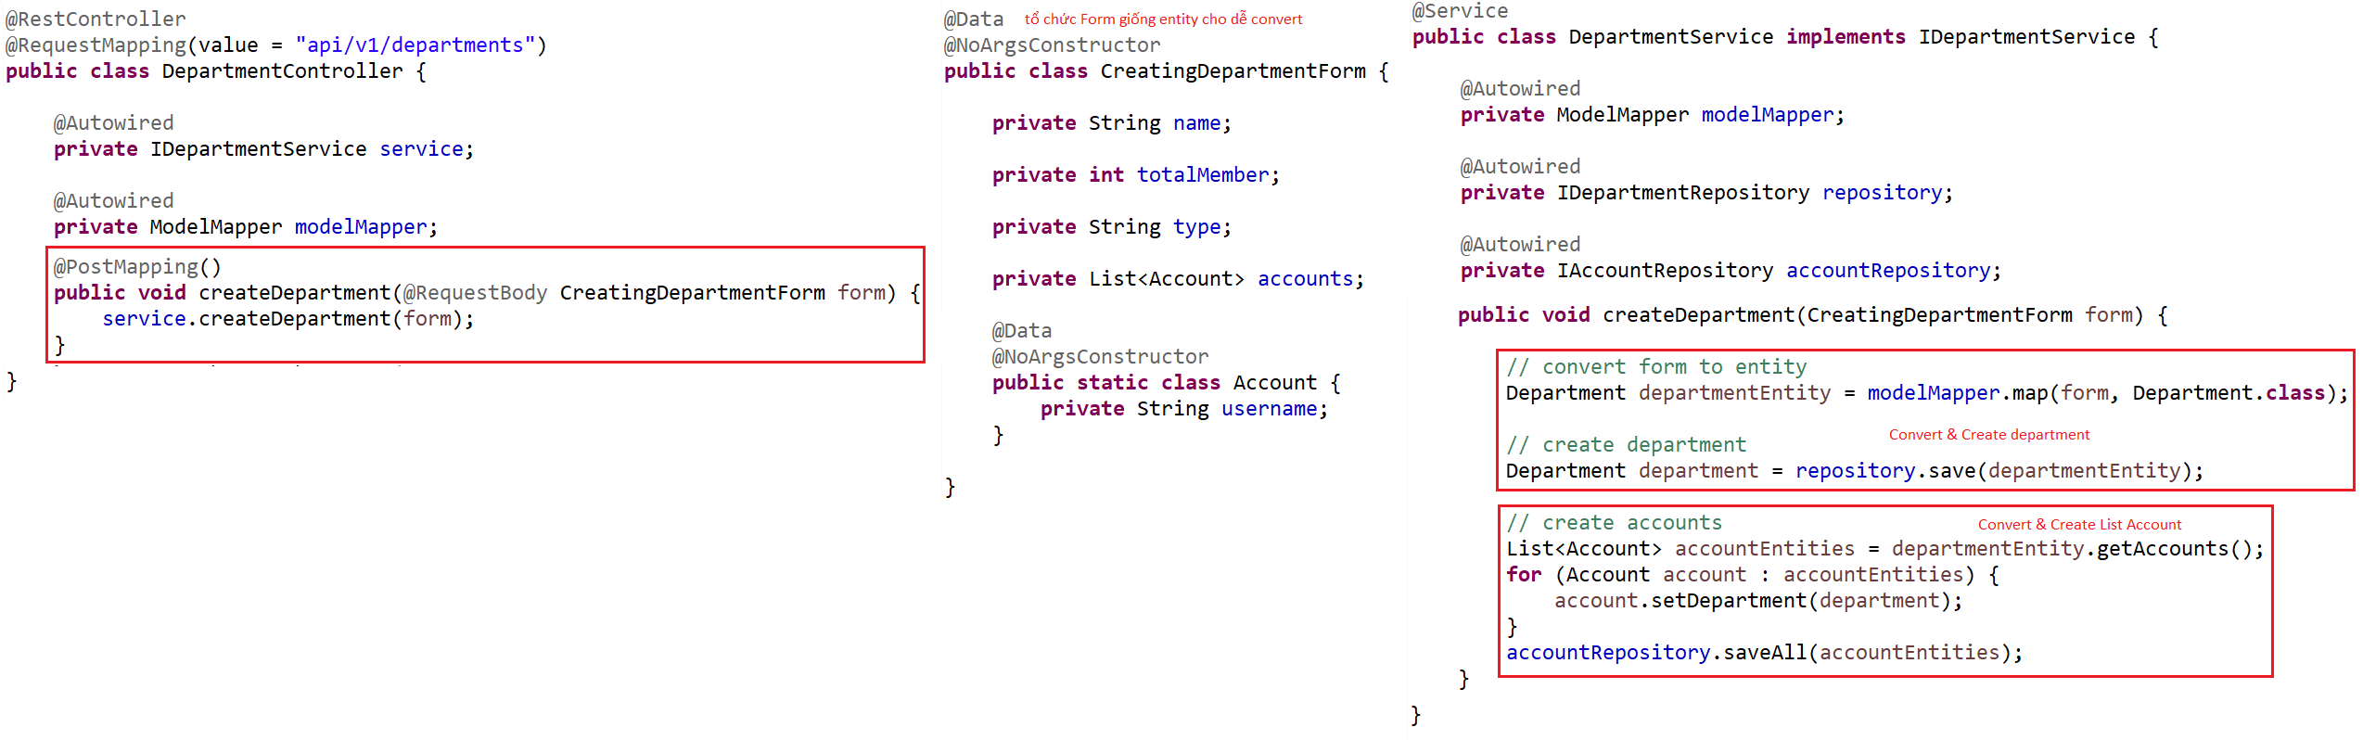
Create/Update Form
Example 3: Create Department & List Account

Slide 9
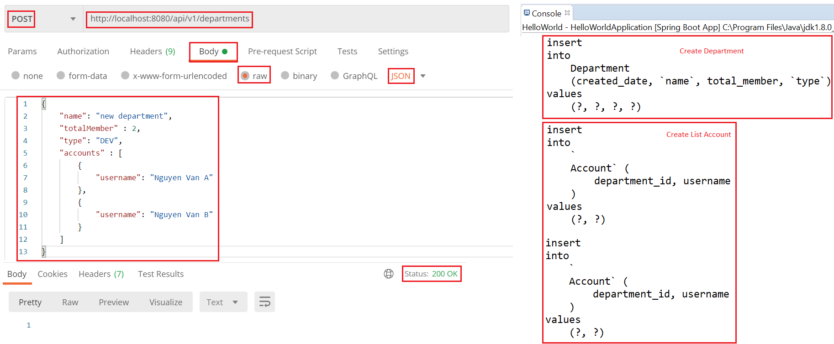
Create/Update Form

Slide 10
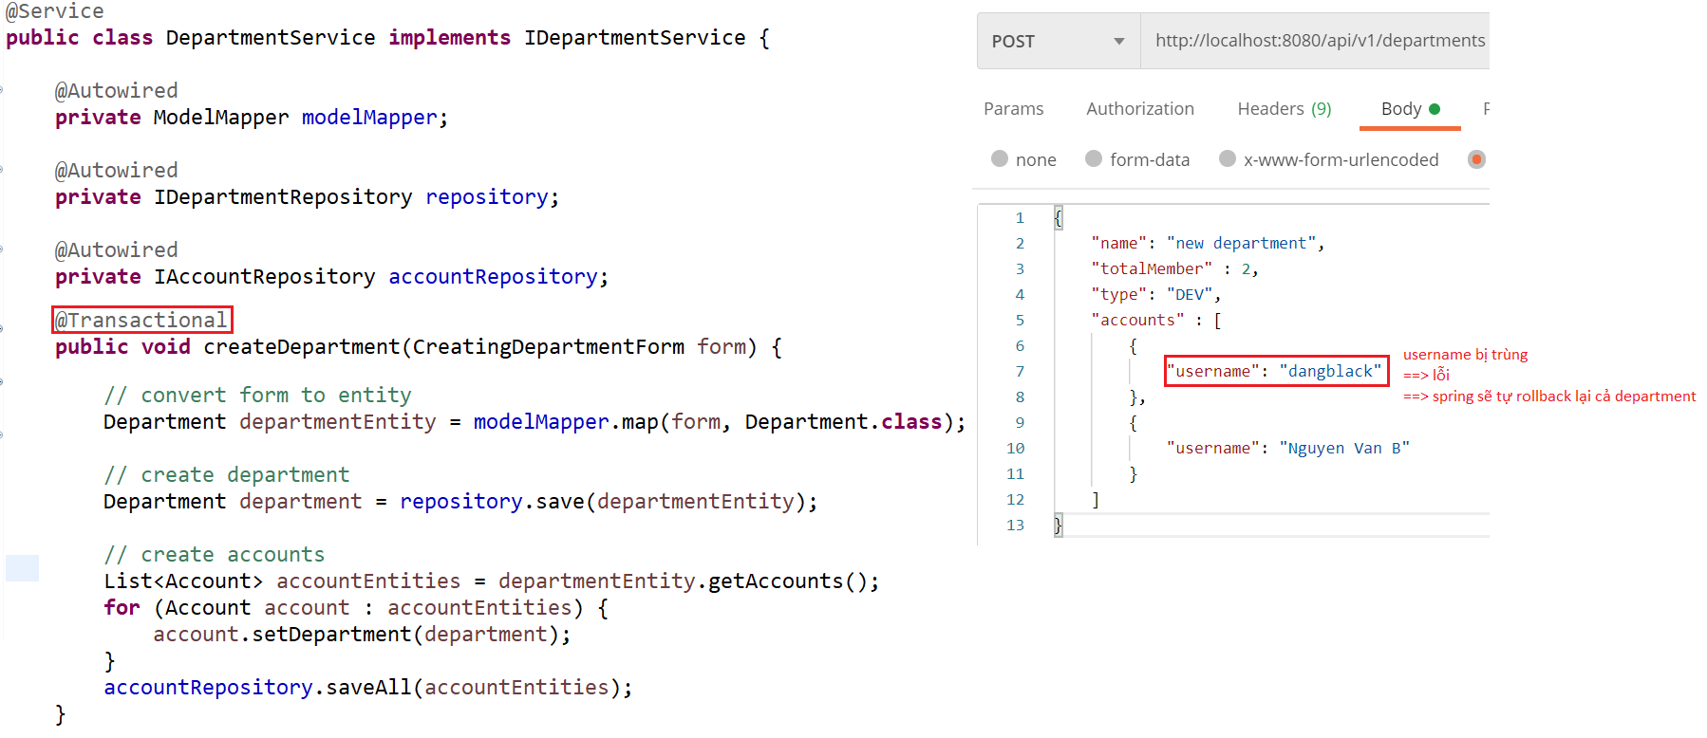
Transaction
Example:

Slide 11
Transaction
Reference: https://www.baeldung.com/transaction-configuration-with-jpa-and-spring

Slide 12
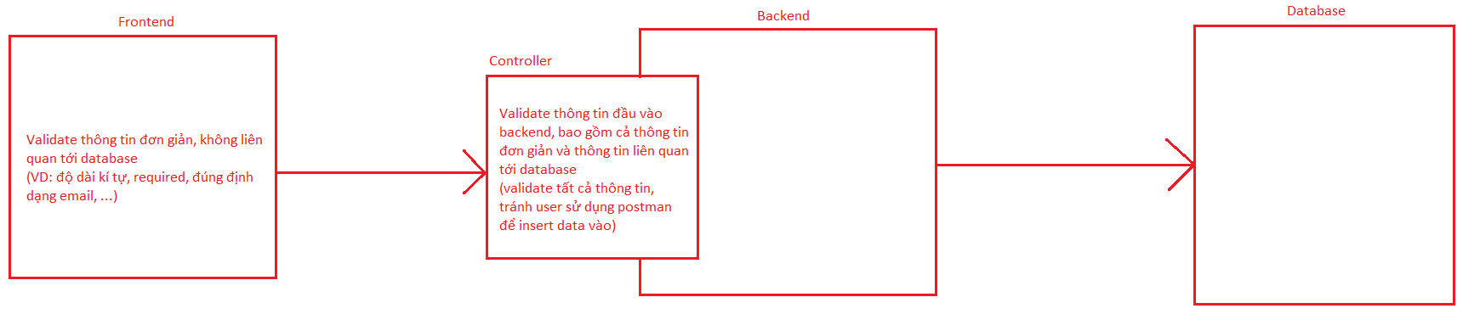
Validate
Bean Validation, Hibernate Validation Libraries
Using for Backend validation

Slide 13
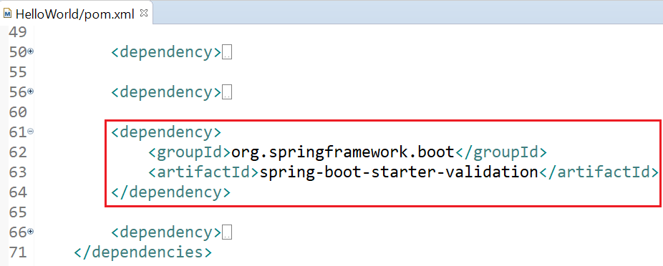
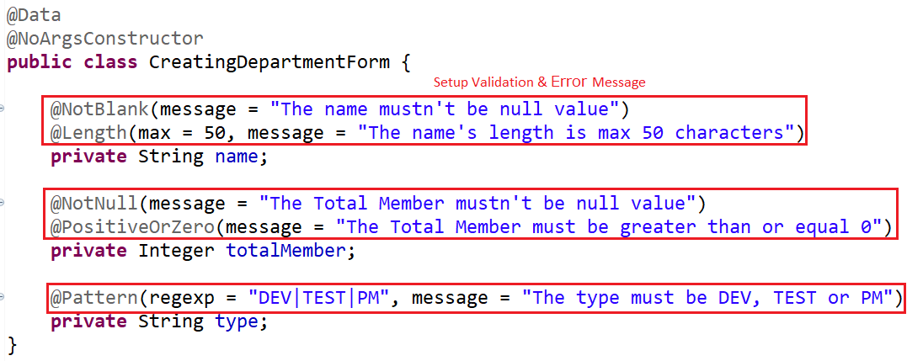
Validate
Example 1:
pom.xml
Form

Slide 14
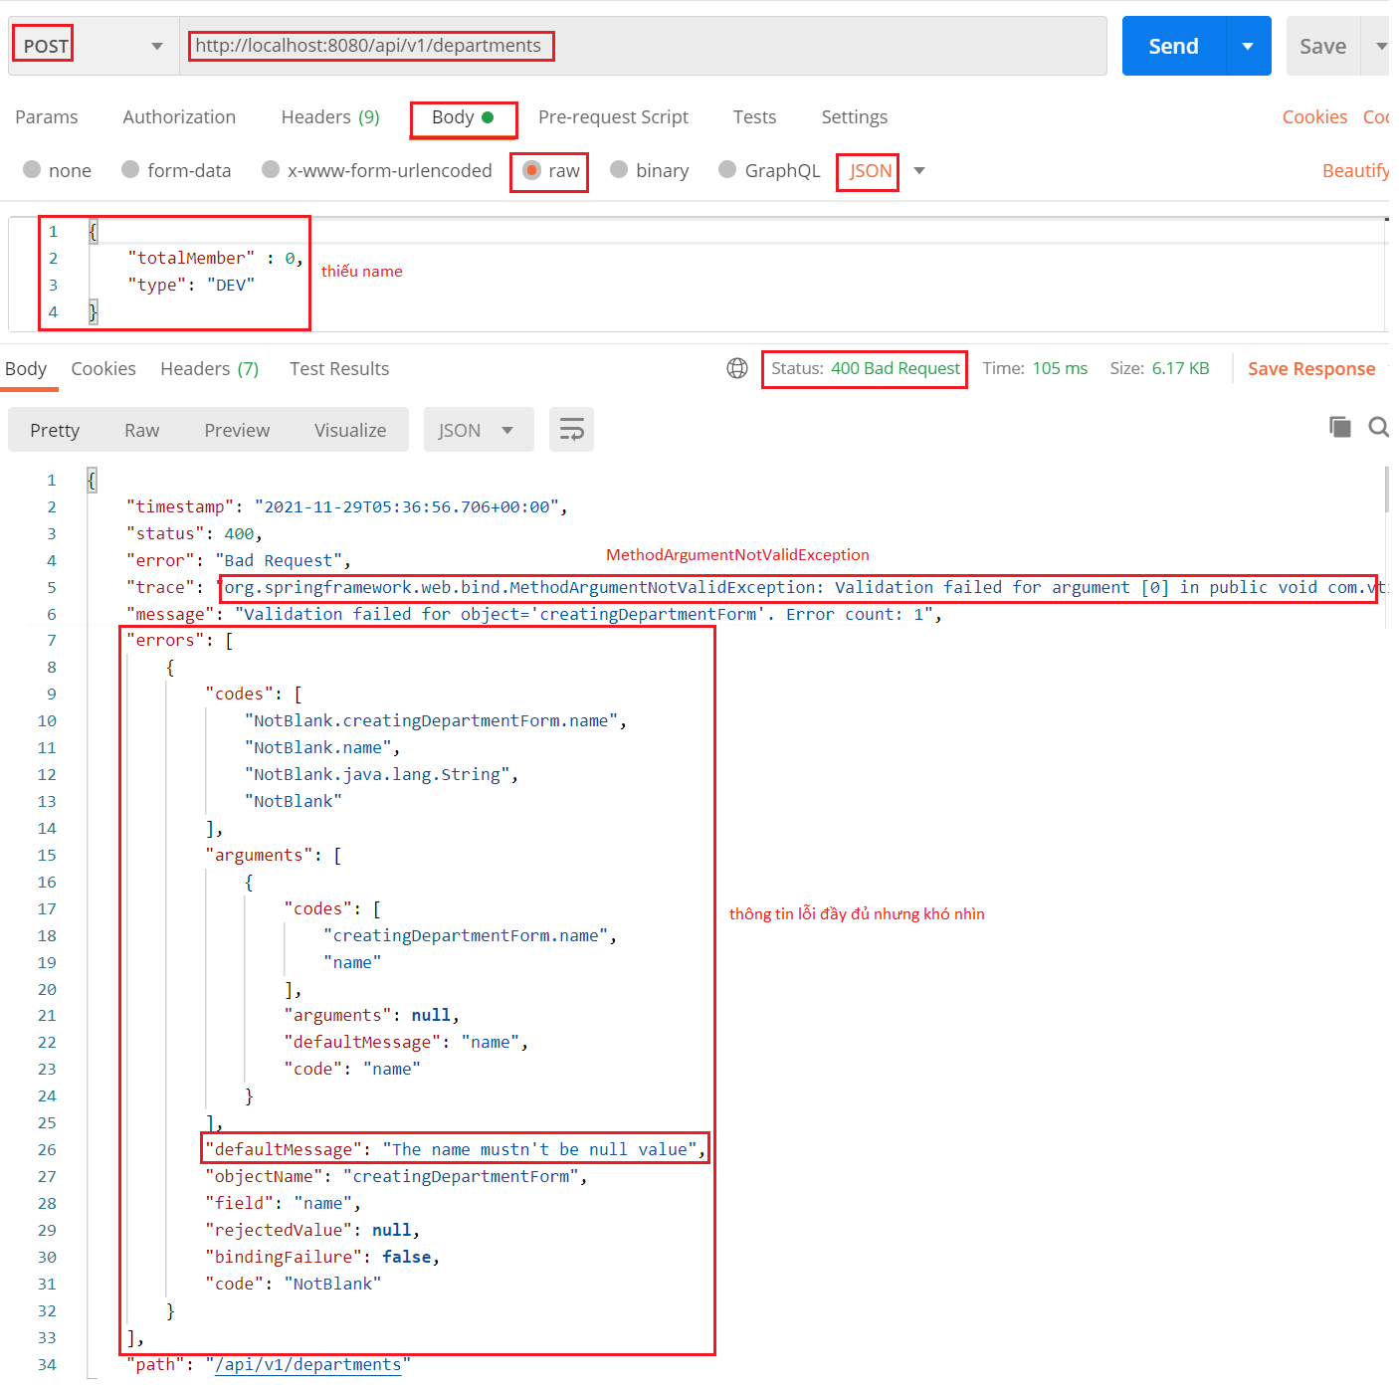
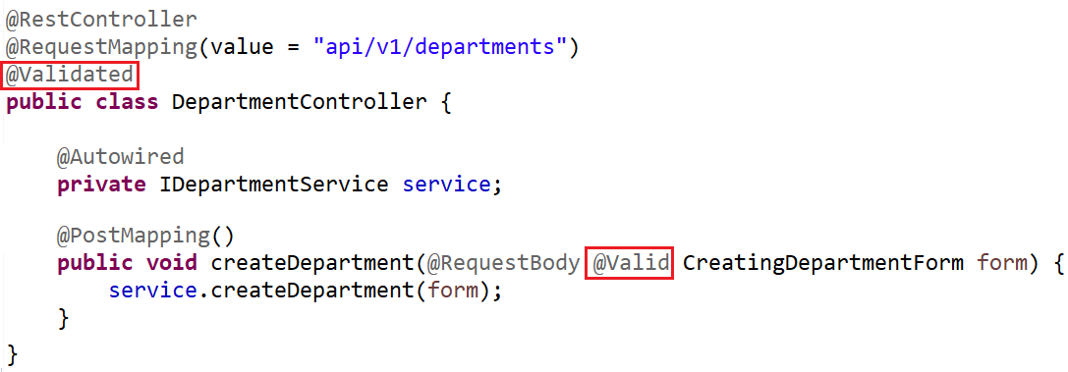
Validate
Controller
Test

Slide 15
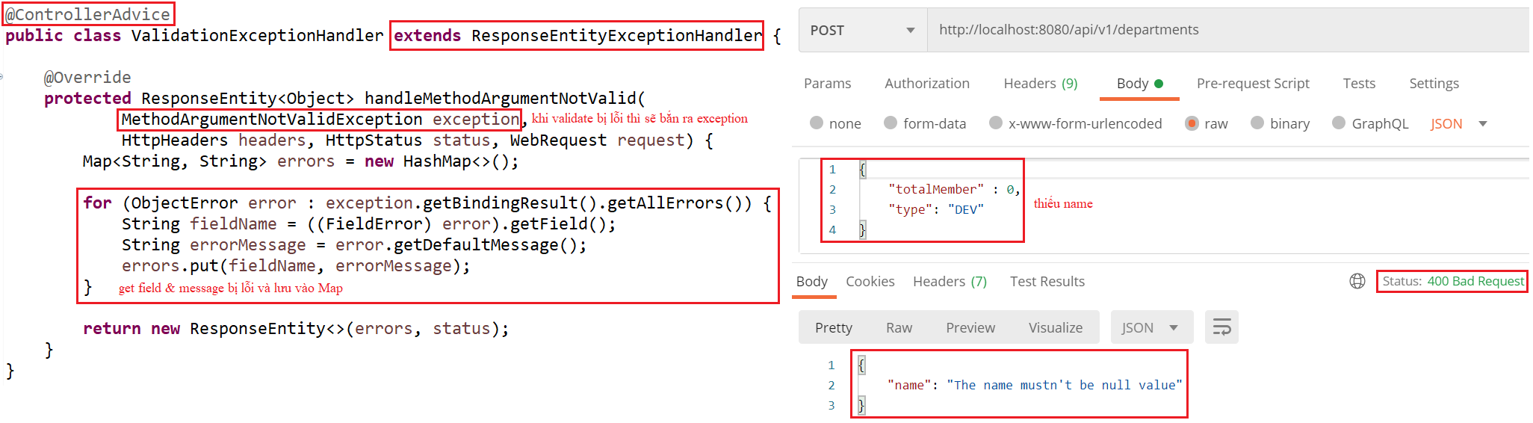
Validate
Example 2: Modify output

Slide 16
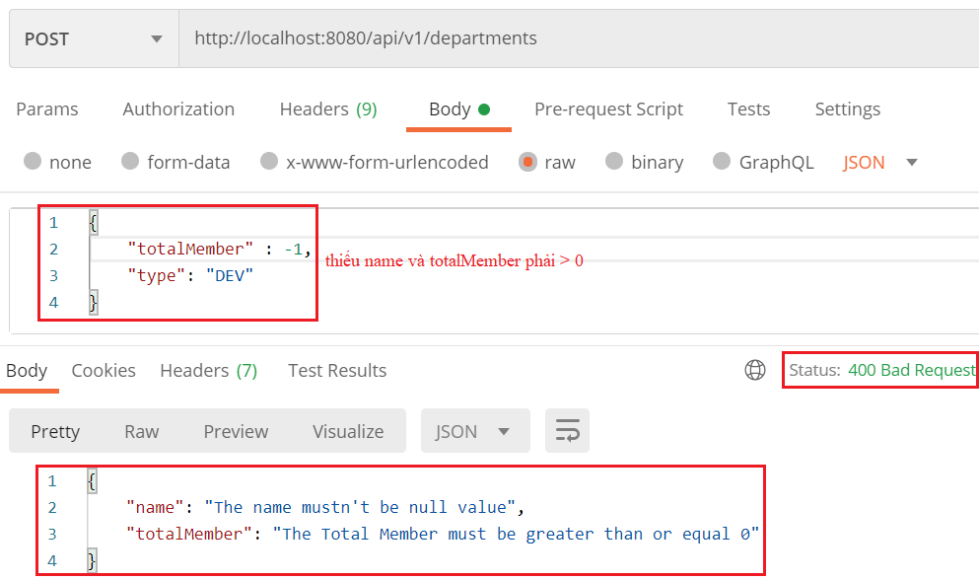
Validate

Slide 17
Validate
Annotation
Annotation | Meaning
@Null @NotNull @NotEmpty @NotBlank | The property must be null The property must not be null The property is not null or empty (applied to String, Collection, Map, Array) The property is not null, empty or whitespace (applied to String)
@Min @Max @Range | The property has a value no smaller than the value attribute
@Positive @PositiveOrZero @Negative @NegativeOrZero | It apply to numeric values and validate that they are strictly positive
@Size @Length @CodePointLength | the annotated property value has a size between the attributes min and max (applied to String, Collection, Map, array) Apply for only String

Slide 18
Validate
@Future @FutureOrPresent @Past @PastOrPresent | A date value is in the future
@DurationMin @DurationMax
@Email @URL @SafeHtml @CreditCardNumber | The property is a valid email address
@UniqueElements | Check a collection does not contain duplicates
@Pattern
https://docs.jboss.org/hibernate/stable/validator/reference/en-US/html_single/#section-builtin-constraints

Slide 19
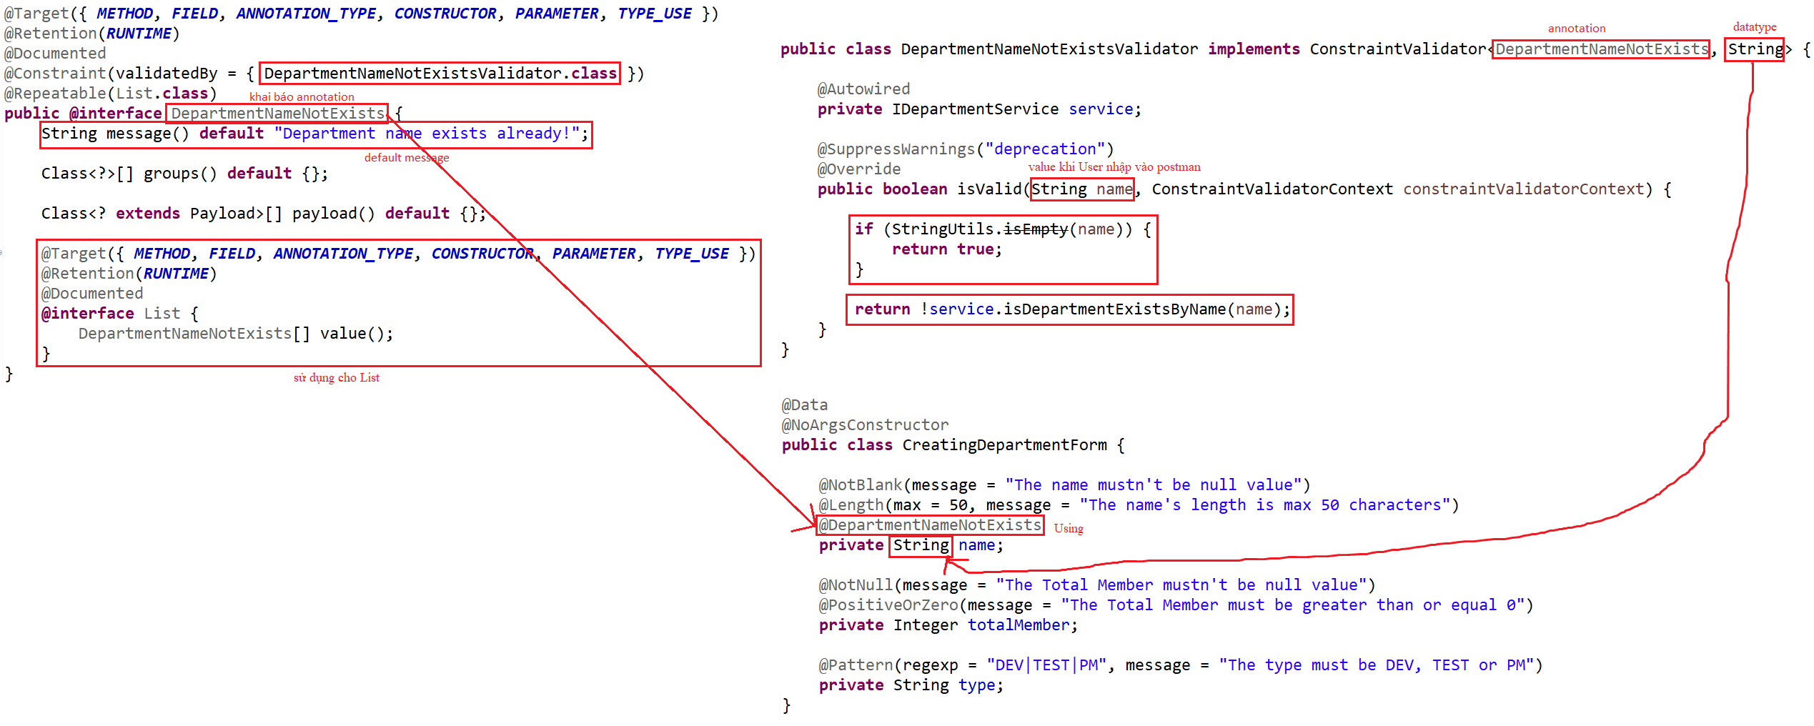
Validate
Example 3: Custom Annotation

Slide 20
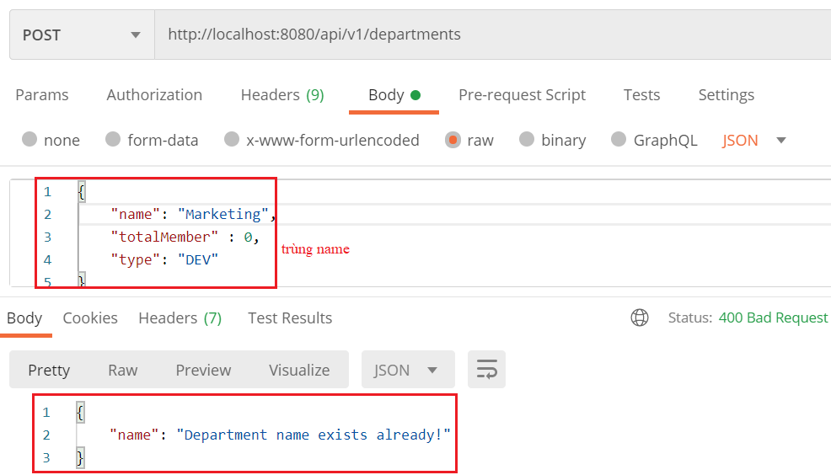
Validate

Slide 21
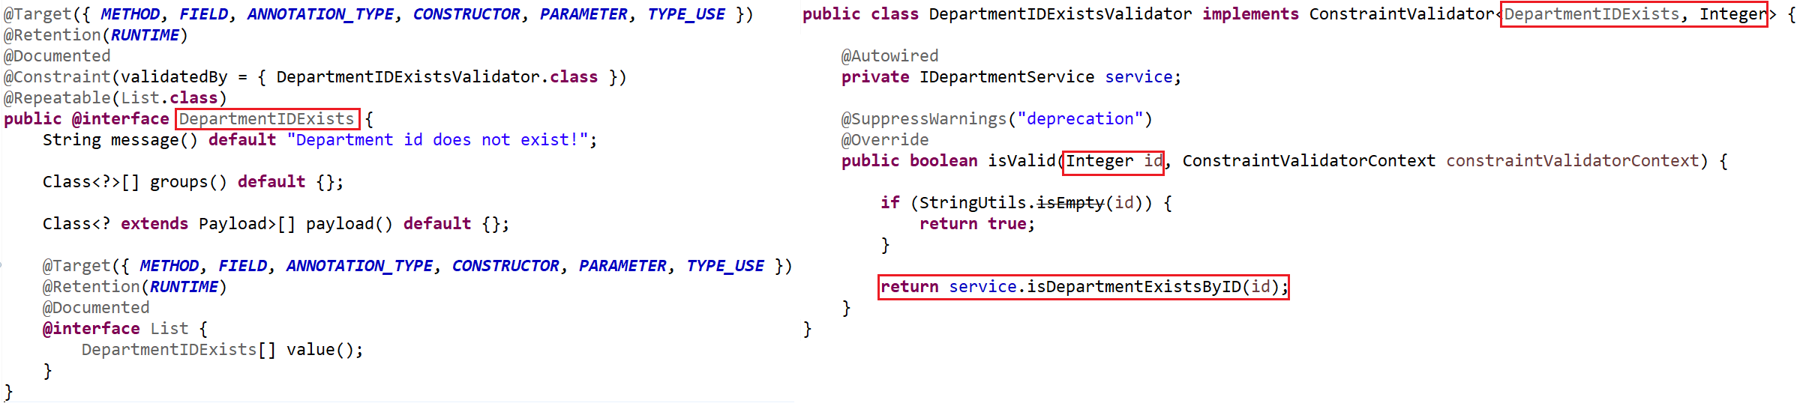
Validate
Example 4: Custom Annotation

Slide 22
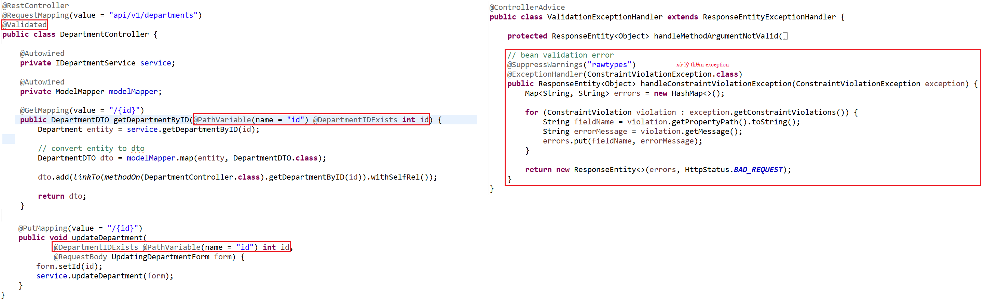
Validate

Slide 23
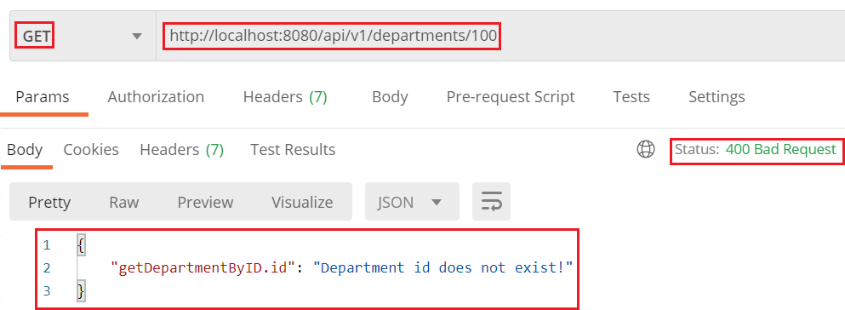
Validate

Slide 24
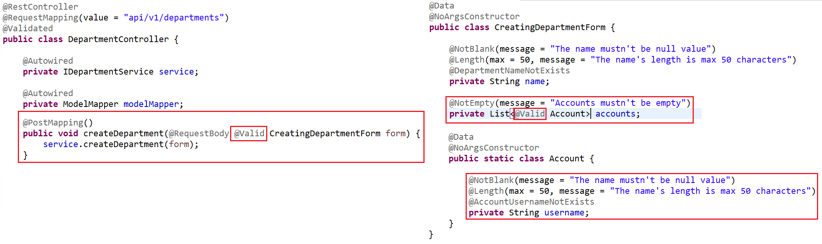
Validate
Example 5: List

Slide 25
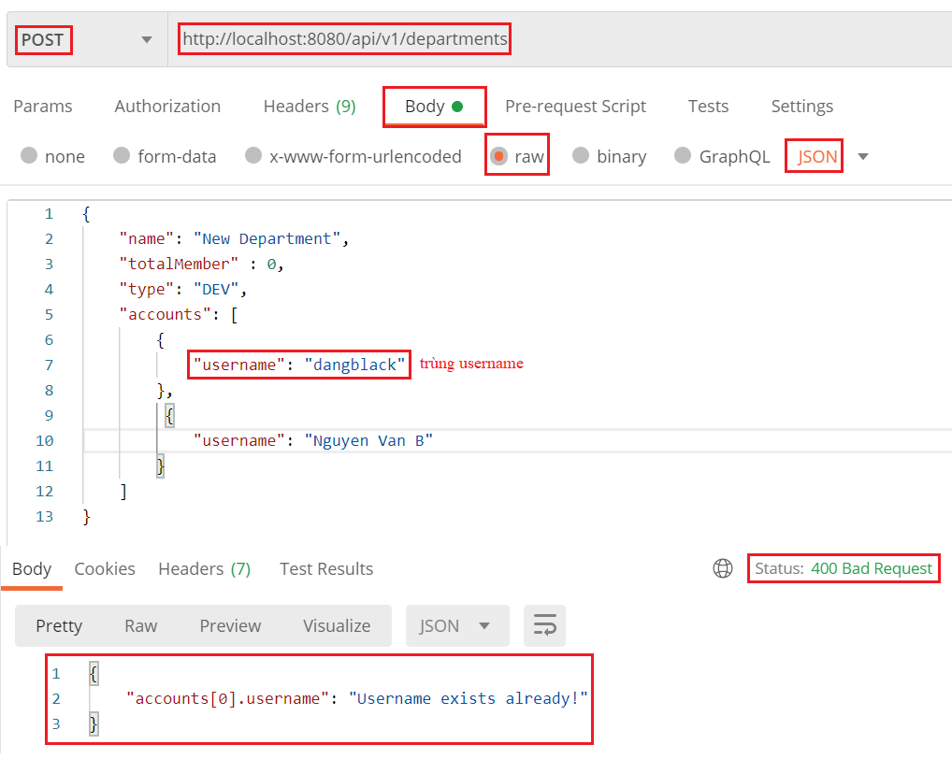
Validate

Slide 26
Q & A
Copyright © VTI Academy All Rights Reserved

